Slide 1

DATS_6103 Final Presentation Predicting Early ASD Traits of Toddlers
Zhe Yu
June 22, 2022

Slide 2
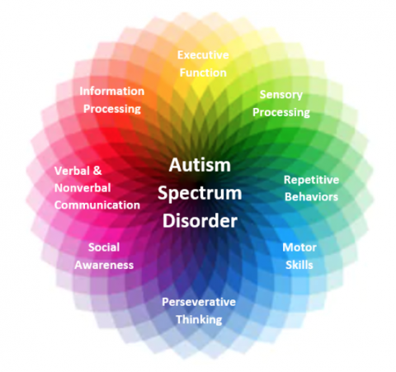
Background
Autism, or autism spectrum disorder (ASD), refers to a broad range of conditions characterized by challenges with social skills, repetitive behaviors, speech and nonverbal communication.
Early diagnosis can significantly reduce the healthcare costs
Time-efficient and accessible ASD screenings is critical for the early diagnosis.

Slide 3

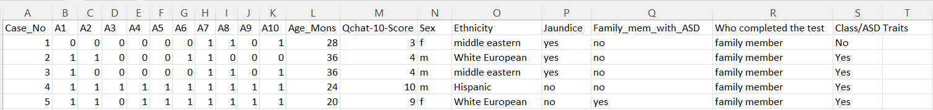
Data set information
The dataset was developed by Dr Fadi Fayez Thabtah (fadifayez.com) using a mobile app called ASDTests (ASDtests.com) to screen autism in toddlers.
Ten behavioral features (Q-Chat-10) plus other features that have proved to be effective in detecting the ASD cases from controls in behavior science.
Improving the classification of ASD cases
Dr. Fadi Fayez Thabtah
Department of Digital Technology
Manukau Institute of Technology
Auckland, New Zealand
1045 rows x 19 colunms

Slide 4
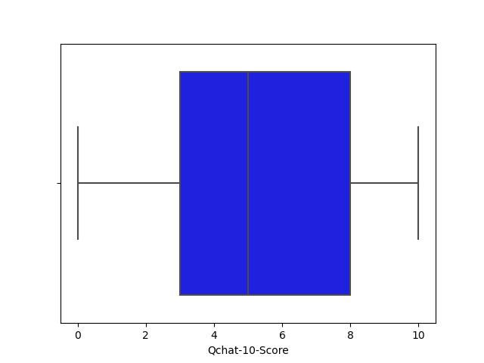
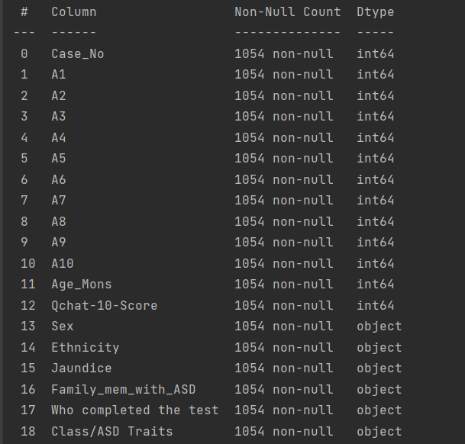
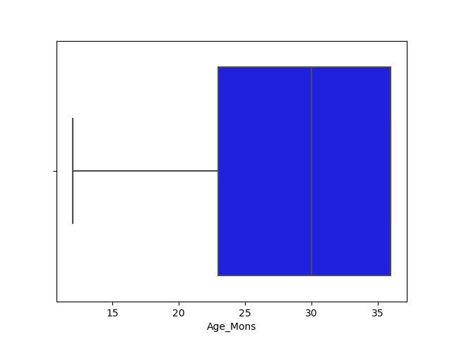
EDA ---- Missing values and Outlier identification

Slide 5
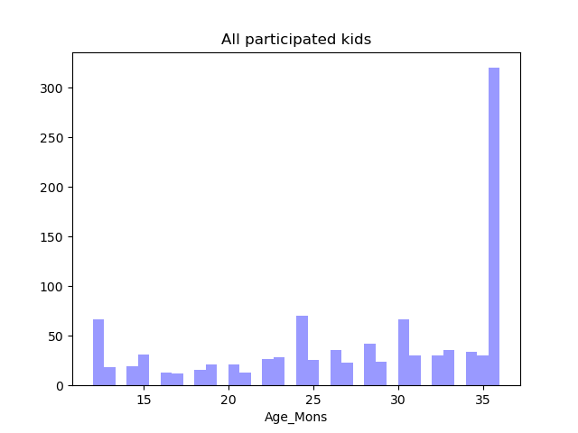
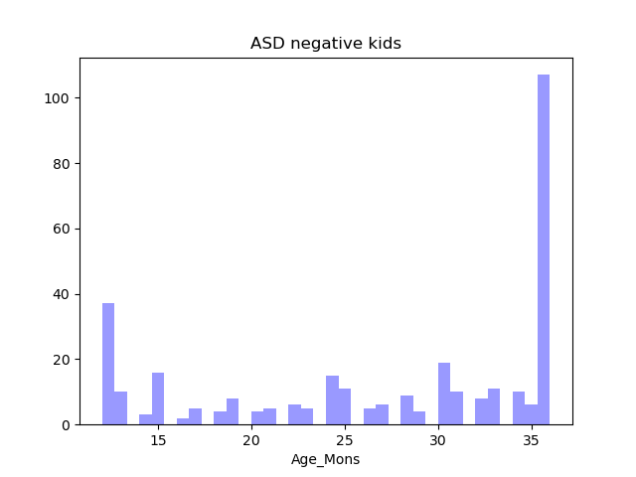
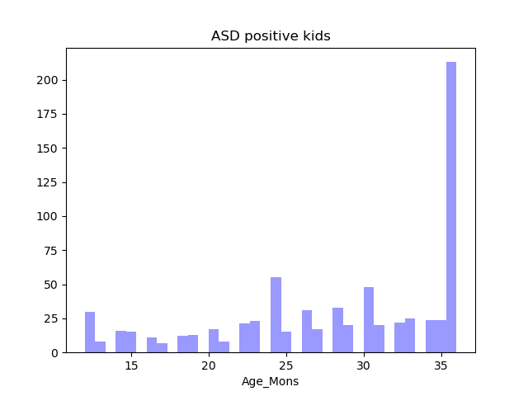
EDA ---- Visualizing the age distribution
Notes:
So for adults most of the ASD positive are around 20 or 30 years of age, whereas for toddlers most of them are around 36months. We can see in adults as the age increases the number decreases, whereas in toddlers as the age increases the number increases. It goes well with the research. For adults, people with autism develop strategies to help them age better. For toddlers, the significant signs of autism reveals around 3 years of age.

Slide 6
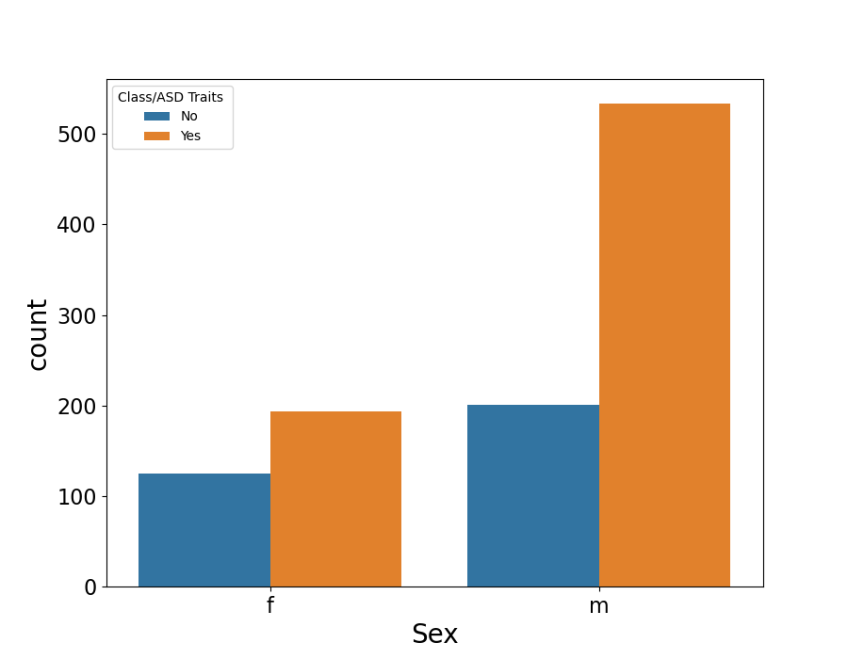
EDA ---- Visualizing relationship between gender and ASD diagnosis

Slide 7
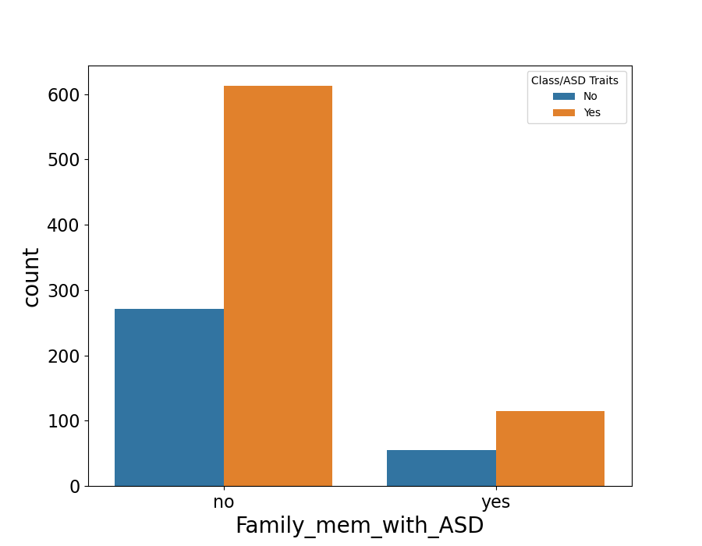
EDA ---- Visualizing effects of family number diagnosis on ASD classification

Slide 8
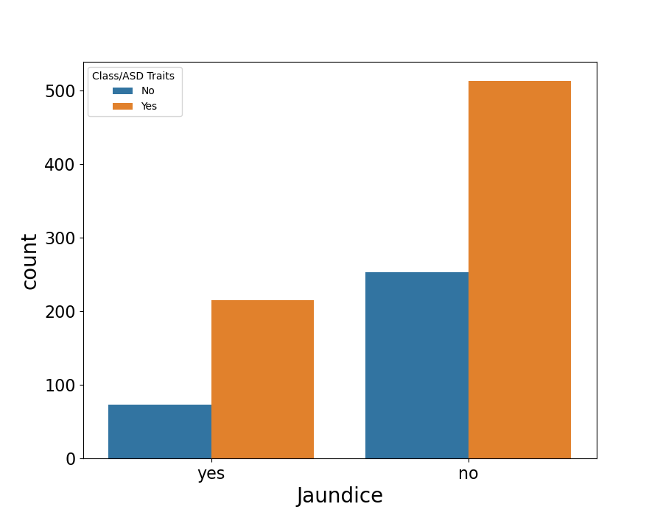
EDA ---- Visualizing relationship between Jaundice and ASD diagnosis

Slide 9
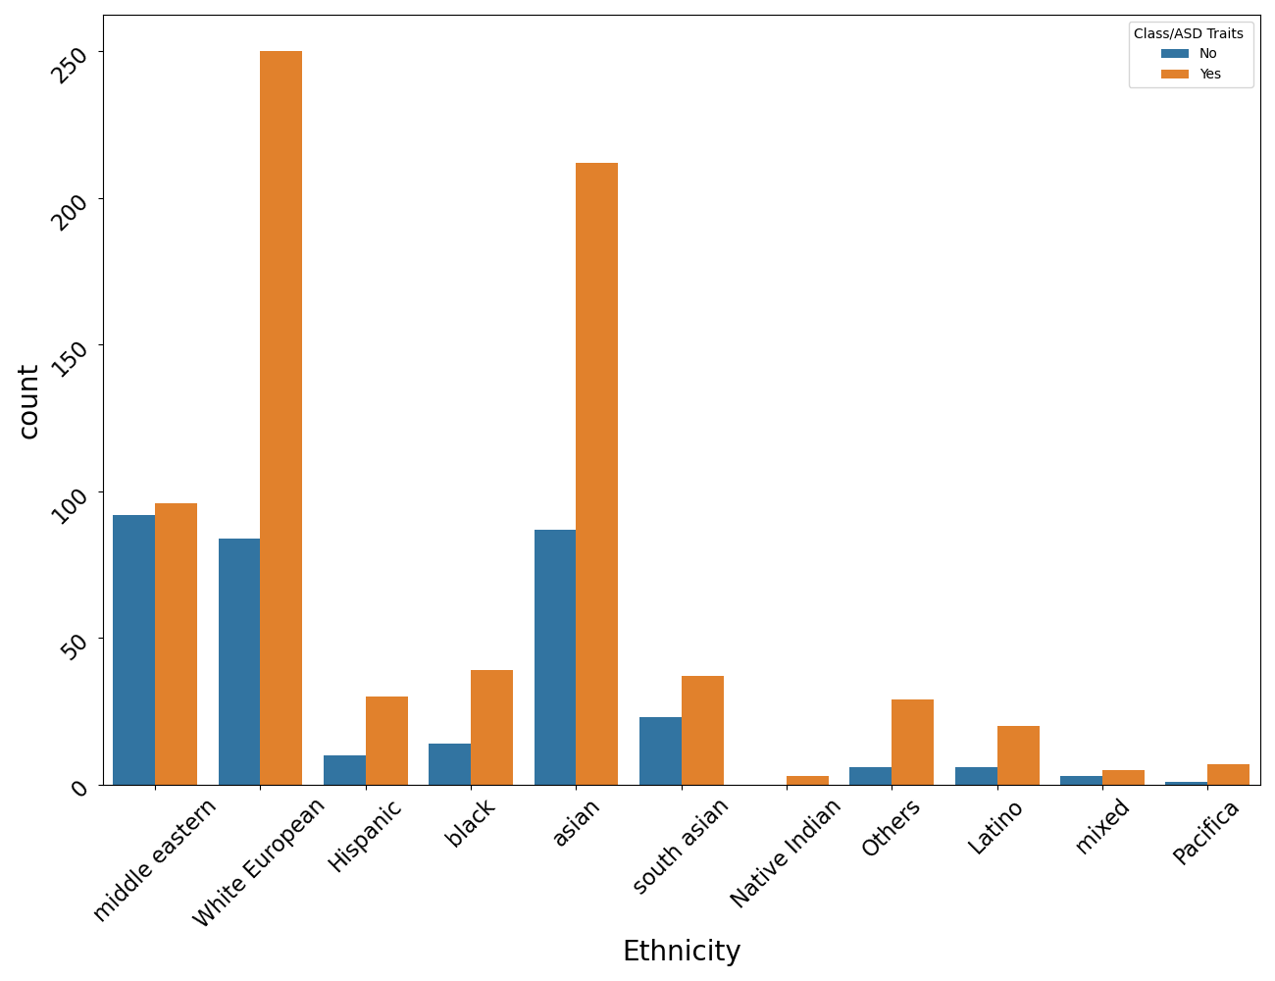
EDA ---- Visualizing relationship between race and ASD diagnosis

Slide 10
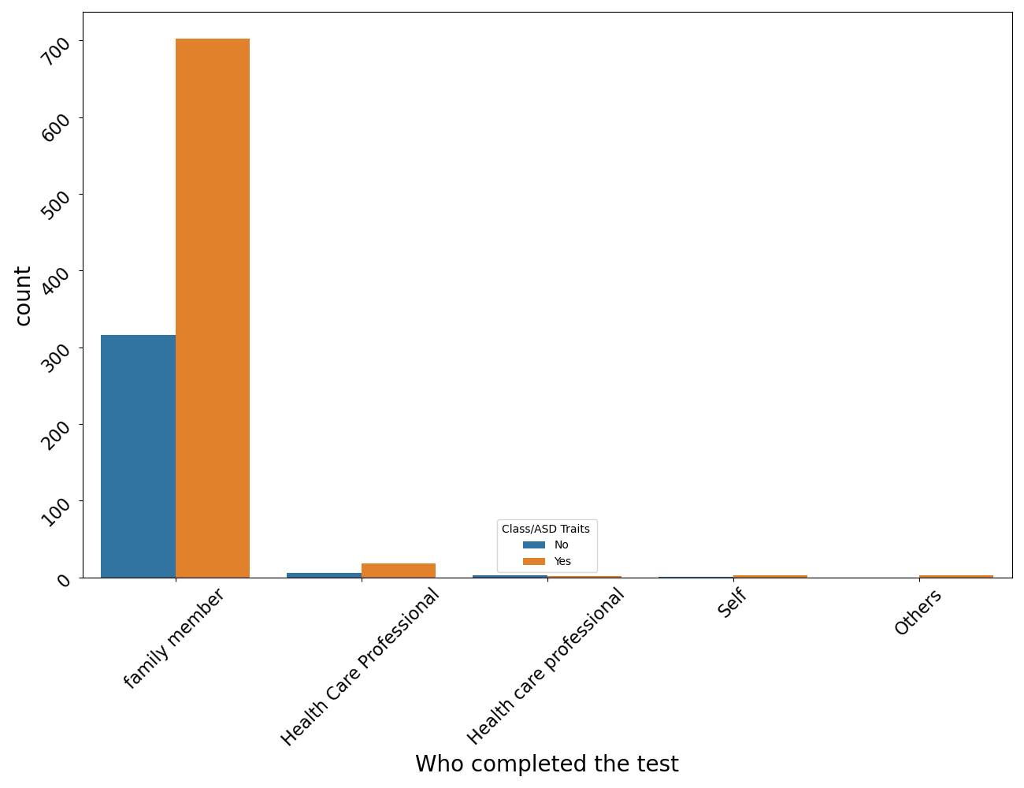
EDA ---- Visualizing “Who completed the test”

Slide 11

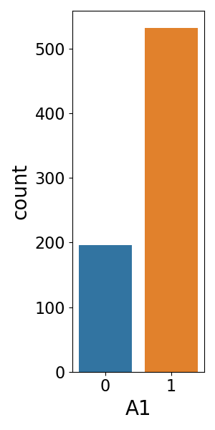
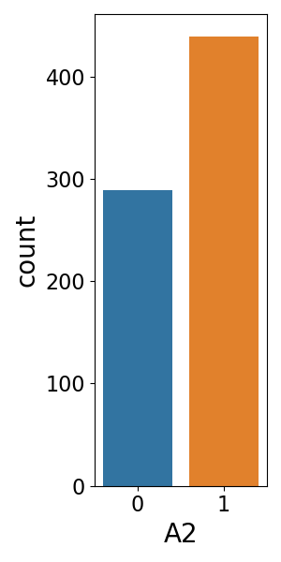
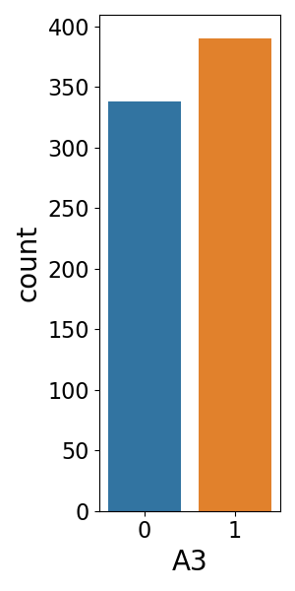
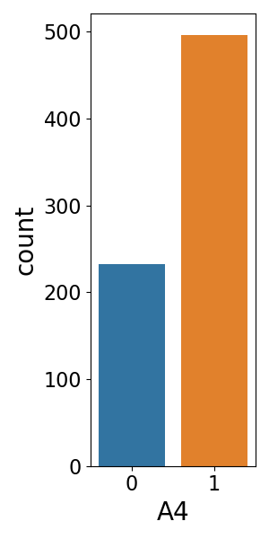
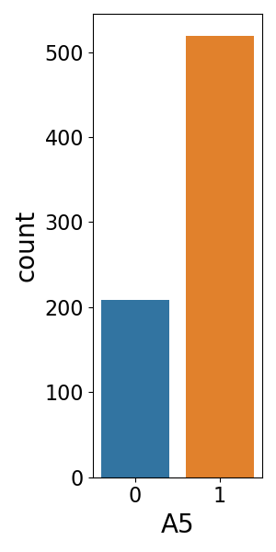
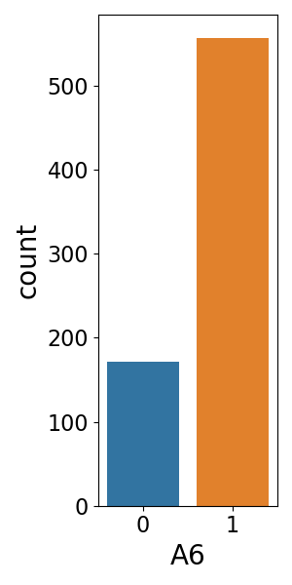
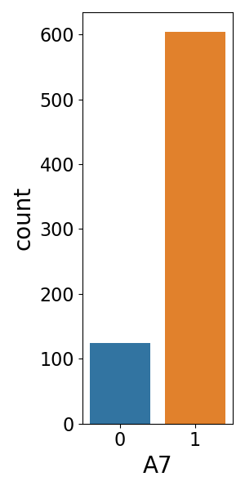

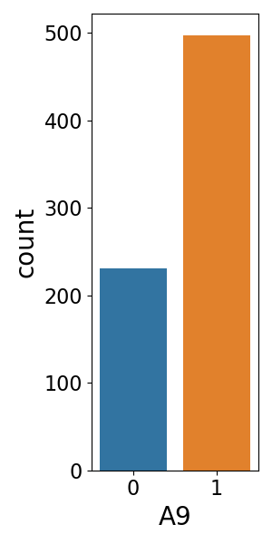
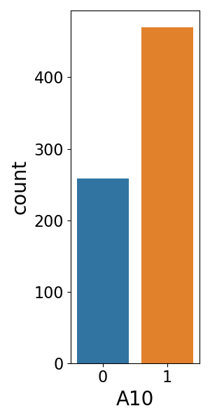
EDA ---- Which behavior happens most in ASD kids
Q chat 10 question features with toddlers:
A1: Does your child look at you when you call his/her name?
A2: How easy is it for you to get eye contact with your child?
A3: Does your child point to indicate that s/he wants something?
A4: Does your child point to share an interest with you?
A5: Does your child pretend? e.g. care for dolls, talk on a toy phone?
A6: Does your child follow where you are looking?
A7: If you or someone else in the family is visibly upset, does your child show signs of waning to comfort them? e.g. stroking hair, hugging them)
A8: Would you describe your child's first word as:
A9: Does your child use simple gestures (e.g. wave goodbye)?
A10: Does your child stare at nothing with no apparent purpose?

Slide 12
EDA ---- Feature Selection
These questions were behavioral questions, and the number of yes were added up and have been recorded in the column called Qchat-10-Score.
If this column has more than 3 yes, toddlers will be classified as positive ASD.
Columns A1-A10 and Qchat-10-Score were removed from the data set before modeling.

Slide 13
Preprocessing
No missing values
No format problem
No outliers
Numeric convert
Standardize the data

Slide 14
Modeling----Strategy
Modeling methods
Decision Tree Classifier (DT)
Random Forrest Classifier (RF)
Logistic Regression (LR)
Gaussian NB
Multinomial NB
K Neighbors Classifier (KNN)
Grid search
Find the best parameters for each method
Ensemble and vote
Evaluate accuracy score by cross-validation, cv = 5
Identify the best modeling method
Notes:
VotingClassifier
cross_val_score
Grid search to find the best parameters
ensemble the methods, VotingClassifier hard vote and soft vote
Evaluate accuracy score by cross-validation, cv = 5
Compare the performance (using the four methods individually and the combine them with hard/soft vote

Slide 15
Modeling--- Grid search
Method | Before grid search | After grid search | Best parameters
DT | 63.03% | 69.67% | criterion: entropy max_depth: 3 min_samples_leaf: 5
RF | 69.19% | 70.62% | max_depth: None, max_features: sqrt, min_samples_leaf: 4 n_estimators: 100
LR | 67.30% | 67.30% | C: 0.001 max_iter: 50 penalty: l1 solver: saga
Gaussian NB | 34.12% | 34.12% | var_smoothing: 1e-09
Multinomial NB | 70.62% | 71.09% | alpha: 10.0
KNN | 69.67% | 73.46% | n_neighbors: 19

Slide 16
Modeling--- Ensemble and Vote
Method | Accuracy
Ensemble and vote (hard) | 72.04%
Ensemble and vote (soft) | 70.14%
DT | 69.67%
RF | 70.62%
LR | 67.30%
Gaussian NB | 34.12%
Multinomial NB | 71.09%
KNN | 73.46%
Only ensembled DT, RF, LR and KNN

Slide 17
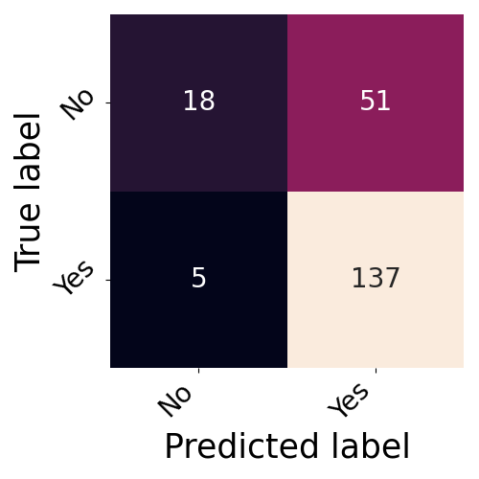
Evaluation
Modeling the dataset using KNN:
 | Precision | Recall | f1-score | Support
0 (No) | 0.78 | 0.26 | 0.39 | 69
1 (Yes) | 0.73 | 0.96 | 0.83 | 142
Accuracy |  |  | 0.73 | 211
macro avg | 0.76 | 0.61 | 0.61 | 211
weighted avg | 0.75 | 0.73 | 0.69 | 211

Slide 18
Conclusion
Among all the classification models used in this research, KNN has the best performance in predicting ASD-like behaviors in toddlers.
Compared to predicting ASD-negative kids, the model can better predict whether a kid is autistic.
Limitations: Better feature selection using sklearn.feature_selection

Slide 19
References
https://www.kaggle.com/datasets/fabdelja/autism-screening-for-toddlers
https://www.youtube.com/watch?v=28xRv-vC9Ys&list=PLreVlKwe2Z0TYh4aCLNw91q9FjRftMSc9&index=2
http://rasbt.github.io/mlxtend/user_guide/classifier/EnsembleVoteClassifier/
https://coderzcolumn.com/tutorials/machine-learning/scikit-learn-sklearn-naive-bayes

Slide 20
Thank you! And Questions?

